Slide 1
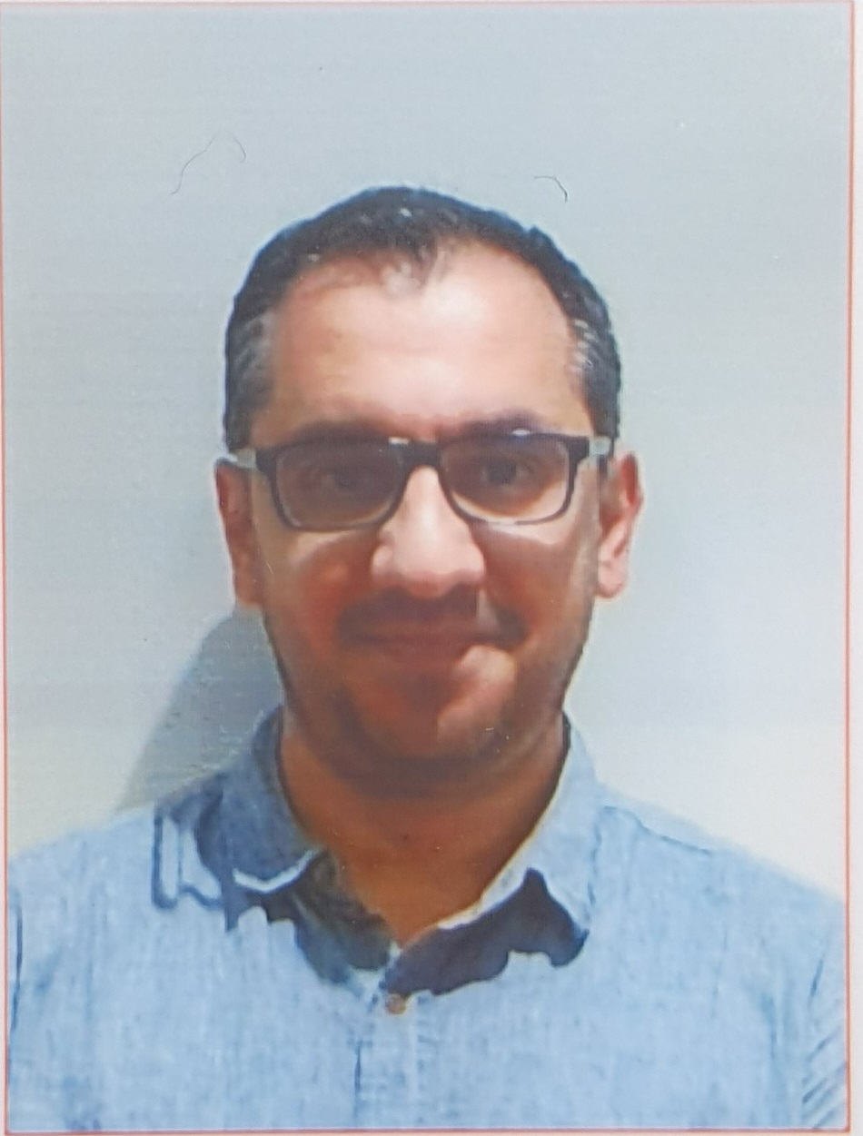
Introduction to Software Engineering (ISE102) Tutorial Week 6

Slide 2
Week 6 Outline
Have you formed your group?
Example & Activity — Campus Parking Permit System
Group Assignment – Part 1: What to do / submit / avoid
Group Assignment – Part 1: Student Operations After Registration – Clarified
Group Assignment – Part 1: Password Rules – Clarified
Mini Coding Nudges (Email/Password, Marks, Pass/Fail etc.)
Allow student. subdomain too
Allow optional - or _ before digits in password
Generate Random Marks and Assign Grades
Make randomness reproducible
Add student ID and PASS/FAIL
Grade Classification Based on University Rules
Group Assignment – Part 2: Build hints (Python-first, JavaFX minority)
Group Assignment – Part 3: Showcase tips
Example & Activity — Event Ticketing Lite
Reference Note for Students

Slide 3
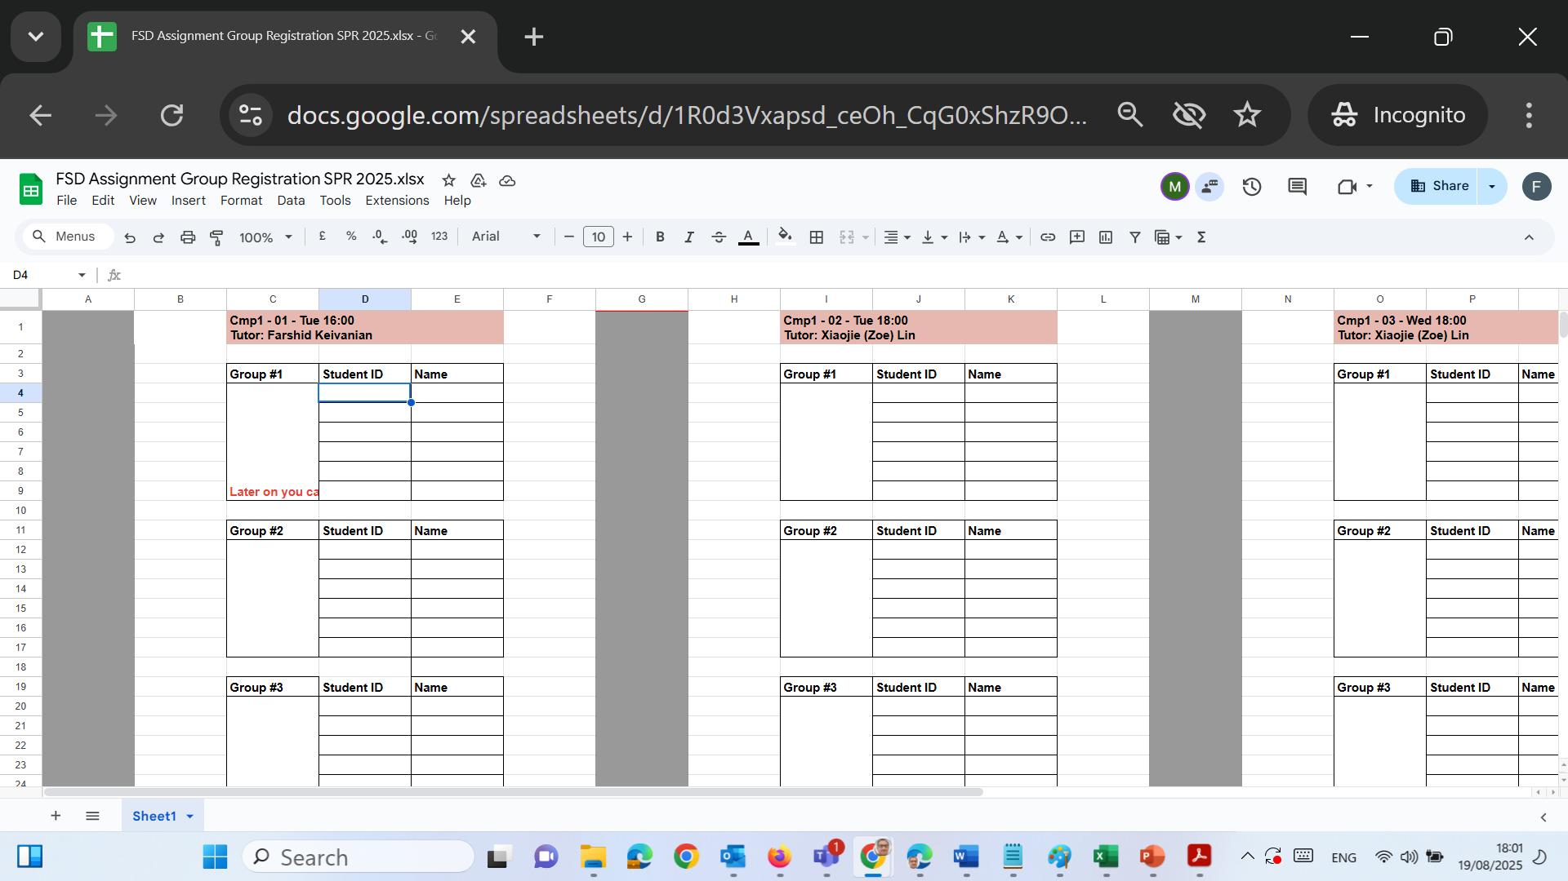
Have you formed your group?
Please send me an email listing your group members and kindly CC all members of your group in the same email. This will help us keep everything clear and ensure everyone is informed. Farshid.Keivanian@uts.edu.au
Once I receive your email, I will fill in the online sheet with your group details and share it with the Unit Coordinator.

Slide 4
Example & Activity — Campus Parking Permit System
(Associations, multiplicity, inheritance, composition, dependency)
Mini case
Students and staff request Parking Permits per semester. A Permit is for one vehicle (plate number) and is valid for one car park zone. Users can hold at most 1 active permit per semester. Security Officers can revoke permits. Payment is Card or Voucher (two subclasses of Payment). When revoked, the permit becomes inactive.
Think about: Candidate Classes, Attributes, Methods, Key Relationship, Multiplicities, etc

Slide 5
Example & Activity — Campus Parking Permit System
Scenario
A university manages Parking Permits for students and staff.
Each User (abstract class) can be either a Student or Staff.
A User can apply for one or more Permits.
Each Permit is for a specific Vehicle (identified by plate number).
The System Admin approves or denies permit applications.

Slide 6
Example & Activity — Campus Parking Permit System
1. Candidate Classes (Rectangles)
Think of classes as blueprints, like a recipe card:
User (abstract – means you can’t create a "User" directly, only Student or Staff)
Subclasses: StudentUser, StaffUser
User <<abstract>>
StudentUser (inherits User)
StaffUser (inherits User)

Slide 7
Example & Activity — Campus Parking Permit System
Generalization (Inheritance)
A User can be either a Student or Staff.
Think: “All users share common things (id, name, email), but each type has its own extras.”
UML: User → Student / Staff
User <<abstract>>
StudentUser (inherits User)
StaffUser (inherits User)

Slide 8
Example & Activity — Campus Parking Permit System
Permit
Permit (id, zone, plate, status, semester)
Payment (abstract)
Subclasses: CardPayment, VoucherPayment
SecurityOfficer (name, id)
ParkingDB (acts like a system storage)
Payment <<abstract>>
CardPayment and VoucherPayment inherit from abstract Payment.
CardPayment (inherits User)
VoucherPayment (inherits User)

Slide 9
Example & Activity — Campus Parking Permit System
Permit (id, zone, plate, status, semester)
Payment (abstract)
Subclasses: CardPayment, VoucherPayment
SecurityOfficer (name, id)
ParkingDB (acts like a system storage)
SecurityOfficer
ParkingDB

Slide 10
Example & Activity — Campus Parking Permit System
User <<abstract>>
2. Attributes (inside rectangles)
Attributes are the "data fields." Example:
User → id, name, email, role (Student or Staff)
Permit → id, zone, plate, status, semester
Permit <<abstract>>
+id
+name
+id
+email
+zone
#role
+plate
+status
+semester

Slide 11
What does the “+” mean?
In UML, symbols in front of attributes/methods show visibility (who can access it):
+ public – anyone can access it (other classes too).
- private – only the class itself can access it.
# protected – the class and its subclasses (children) can access it.
~ package – only classes in the same package/module can access it.
So in the diagram we see, +name means name is public.
User <<abstract>>
+id
+name
+email
#role

Slide 12
Example & Activity — Campus Parking Permit System
Why is #role Protected?
In the diagram, +id, +name, +email are public because they need to be widely accessed (e.g., to display or look up a user).
#role is protected because:
It’s an internal property that only subclasses (like Student and Staff) and the system itself should use.
User <<abstract>>
Permit <<abstract>>
+id
+name
+id
+email
+zone
#role
+plate
+status
+semester

Slide 13
Example & Activity — Campus Parking Permit System
User <<abstract>>
We don’t want every external class (like Vehicle or Permit) directly changing the role of a user.
For example, only the User hierarchy should decide whether someone is a Student, Staff, or Admin.
Permit <<abstract>>
+id
+name
+id
+email
+zone
#role
+plate
+status
+semester

Slide 14
Example & Activity — Campus Parking Permit System
In simple words:
public (+) → information we want everyone to see/use (e.g., name, id).
protected (#) → information we only want children of User (Student, Staff) to use, but not outsiders.
This keeps the system safe and structured.
User <<abstract>>
Permit <<abstract>>
+id
+name
+id
+email
+zone
#role
+plate
+status
+semester

Slide 15
Example & Activity — Campus Parking Permit System
SecurityOfficer
SecurityOfficer (name, id)
VehicleInfo (plate, make)
ParkingDB (savePermit(), readPermit())
+name
VehicleInfo
+id
plate
ParkingDB
make
savePermit()
readPermit()

Slide 16
Example & Activity — Campus Parking Permit System
VoucherPayment
VoucherPayment (voucherid)
CardPayment (cardNo, authNo)
Payment (amount, time)
+voucherid
CardPayment
cardNo
Payment
authNo
+amount
+time

Slide 17
Example & Activity — Campus Parking Permit System
User <<abstract>>
3. Methods (actions, shown as ovals linked)
Think of methods as actions the class can do:
User: requestPermit(), login()
Permit: activate(), revoke(), assignVehicle()
Payment: processPayment()
SecurityOfficer: revokePermit()
ParkingDB: savePermit(), readPermit()
+id
+name
+email
#role

Slide 18
User Class (Rectangle: data blueprint).
User (abstract): we don’t create a plain User; you create StudentUser or StaffUser (inheritance shown by hollow-triangle arrows).
Attributes (top middle section)
+id: int, +name: string, +email: string are public.
#role is protected (User + its children can see it).
Methods (bottom middle section)
+login(email, password): bool
+requestPermit(plate, zone, semester): Permit
~cancelRequest() is package visibility (same module only).
User <<abstract>>
+id: int
+name: string
+email: string
#role {Student, Staff}
+login()
+requestPermit()
~cancelRequest()

Slide 19
Association (Relationship)
The line from User to Permit is labeled “requests” to use an action verb/or from Permit to User “requests by”.
User <<abstract>>
+id: int
(1, 1)
Permit (per semester)
A user may have zero or one active permit in a semester (optional on the permit side).
A permit is requested by only one user at a time (mandatory)
+name: string
Permit <<abstract>>
+email: string
(0, 1)
#role {Student, Staff}
+id
Requests by
+zone
+login()
+plate
+requestPermit()
+status
~cancelRequest()
+semester

Slide 20
Association (Relationship)
User <<abstract>>
Each User can have 0 or 1 permit (per semester).
Each Permit must belong to exactly 1 User.
Example: Ali (Student) applies → he can only hold one active permit for Semester 1.
+id: int
(1, 1)
+name: string
Permit <<abstract>>
+email: string
(0, 1)
#role {Student, Staff}
+id
Requests by
+zone
+login()
+plate
+requestPermit()
+status
~cancelRequest()
+semester

Slide 21
Multiplicity (numbers on relationships)
Multiplicity means "how many objects can connect."
User (1) ── (0..1) Permit → One user can have at most 1 permit per semester. → Permit is optional (0..1 means may not exist).
User <<abstract>>
+id: int
(1, 1)
+name: string
Permit <<abstract>>
+email: string
(0, 1)
#role {Student, Staff}
+id
Requests by
+zone
+login()
+plate
+requestPermit()
+status
~cancelRequest()
+semester

Slide 22
Visibility (Access Control)
+ (public): anyone can see it → e.g., +name, +email
- (private): only the class itself → e.g., -password
# (protected): only the class & subclasses → e.g., #role
User <<abstract>>
+id: int
(1, 1)
+name: string
Permit <<abstract>>
+email: string
(0, 1)
#role {Student, Staff}
+id
Requests by
+zone
+login()
+plate
+requestPermit()
+status
~cancelRequest()
+semester

Slide 23
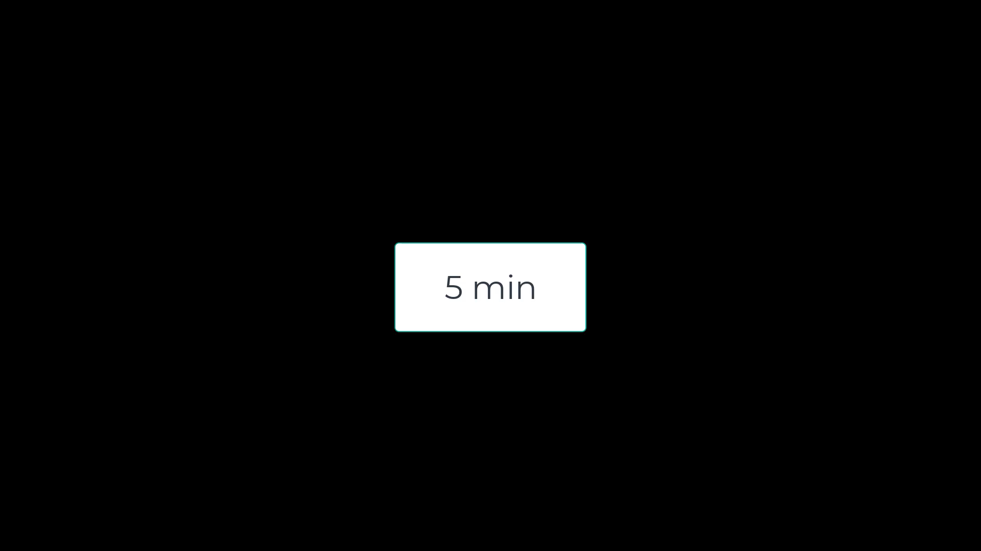
Example & Activity — Campus Parking Permit System
We have completed the User–Permit part together. Now, please design the rest of the UML diagram by adding:
Permit–Payment (mandatory relationship, action label ‘requires’).
SecurityOfficer–Permit (dependency with revoke action).
Permit–VehicleInfo (composition, black diamond). Remember to use rectangles for classes, ovals for methods, and mark multiplicity (0..1, 1, etc.).”

Slide 24
Example & Activity — Campus Parking Permit System
Complete the UML Relationships
Permit–Payment (mandatory)
Permit (1) ── (1) Payment
Action: “requires”
Explain: every permit must have exactly one payment when created.
SecurityOfficer–Permit (dependency)
Dashed arrow SecurityOfficer ──> Permit
Action: “revoke()”
Explain: dependency, because SecurityOfficer needs Permit to perform revoke.

Slide 25
Composition (Strong Link)
Each Permit is tied to exactly one Vehicle (by plate number).
If the permit is deleted, the vehicle link also disappears from the permit system.
UML: Permit ♦─1..1 Vehicle
Permit <<abstract>>
Permit–VehicleInfo (composition)
Black diamond at Permit side.
Multiplicity: 1 Permit → 1 VehicleInfo
Explain: if Permit is deleted, VehicleInfo is deleted too.
VehicleInfo
+id
(1, 1)
+zone
(1, 1)
plate
+plate
make
+status
+semester

Slide 26
Composition (Strong Link)
Composition (black diamond at Permit side) → means a VehicleInfo cannot exist without its Permit. If the Permit is deleted, the VehicleInfo tied to it is also deleted.
Permit <<abstract>>
Multiplicity (1,1) → each Permit is tied to exactly one VehicleInfo, and each VehicleInfo belongs to exactly one Permit.
VehicleInfo
+id
(1, 1)
+zone
(1, 1)
plate
+plate
make
+status
+semester

Slide 27
Attributes:
Permit has fields like id, zone, plate, status, semester.
VehicleInfo has plate and make.
Permit <<abstract>>
VehicleInfo
+id
(1, 1)
+zone
(1, 1)
plate
+plate
make
+status
+semester

Slide 28
Example & Activity — Campus Parking Permit System
Permit (1) ── (1) Payment → Every permit needs exactly one payment at the time of issue.
SecurityOfficer ──> Permit → A Security Officer can revoke (dependency arrow).
Permit ── VehicleInfo (composition) → Permit owns vehicle info (plate, make). If permit deleted → vehicle info deleted.

Slide 29
Example & Activity — Campus Parking Permit System
5. Optional vs Mandatory
Optional: Permit for a User (not all users will request one).
Mandatory: Payment for Permit (no free permits).

Slide 30
Example & Activity — Campus Parking Permit System
6. Action Verbs
Relationships should use verbs:
User requests Permit.
Permit requires Payment.
Security Officer revokes Permit.
ParkingDB stores Permits.

Slide 31
Example & Activity — Campus Parking Permit System
7. Include / Exclude (use cases)
100 User logs in → include validate credentials.
200 Request permit → include take payment, save record.
210 Prevent >1 active permit → exclude if user already has permit.
300 Security revokes permit → include change status to inactive.
400 Admin lists permits → include filter by zone, semester.

Slide 32
Example & Activity — Campus Parking Permit System
Simple Story Example
Ali (Student) logs in and applies for a parking permit.
His User account (Student) is linked to Permit #123.
Permit #123 is tied to his Vehicle (plate ABC-123).
If the permit is revoked, the vehicle–permit link is gone too.

Slide 33
Example & Activity — Campus Parking Permit System
8. Dependency
Dependency means one class needs another to do something.
Example: SecurityOfficer → Permit (dependency: revoke()). Without Permit, revoke() makes no sense.

Slide 34
Example & Activity — Campus Parking Permit System
9. Composition vs Aggregation
Permit – VehicleInfo = Composition (solid diamond).
Permit has VehicleInfo (plate, make) — if permit deleted, vehicle info goes too.
Reason: Vehicle info cannot exist separately from Permit. (When permit deleted, vehicle info goes away too.)

Slide 35
Group Assignment – Part 1: What to do / submit / avoid
Do:
Scope summary (what’s in / out).
Backlog table with 3-digit IDs grouped by feature.
Use case diagram + 1–2 lines per actor/use case.
Class diagram with visibility, multiplicity, relationships.
Data file design (JSON/CSV example lines).
Tiny traceability table.
Avoid: broad stories, missing multiplicities, unlabeled include/extend, GUI detail (keep CLI focus), ignoring constraints (IDs, regex, grade rules).

Slide 36
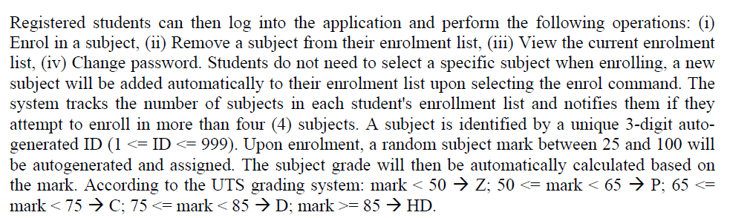
Group Assignment – Part 1: Student Operations After Registration – Clarified
Clarification of the Paragraph in Page 1
Once a student has registered, they can log in and do 4 main things:

Slide 37
Group Assignment – Part 1: Student Operations After Registration – Clarified
Enrol in a subject (system auto-adds a new subject, they don’t pick from a list).
Remove a subject.
View their current enrolment list.
Change their password.

Slide 38
Group Assignment – Part 1: Student Operations After Registration – Clarified
Each subject gets a 3-digit ID (like 007, 125), created by the system.
When a student enrols, the system also generates:
a random mark between 25–100,
and a grade (Z, P, C, D, HD) based on UTS rules.

Slide 39
Group Assignment – Part 1: Student Operations After Registration – Clarified
Students can only enrol in up to 4 subjects. If they try for more, the system shows an error.
All this info is stored in the file students.data.

Slide 40
Group Assignment – Part 1: Student Operations After Registration – Clarified
Example
Leila registers successfully.
She enrols in a subject → system assigns subject ID = 042, mark = 78, grade = D.
She enrols again → subject ID = 317, mark = 92, grade = HD.
Now her enrolment list shows:
Subject 042 → mark 78 → grade D
Subject 317 → mark 92 → grade HD
If she tries to enrol a 5th subject, system blocks it and shows: "You cannot enrol in more than 4 subjects."

Slide 41
Group Assignment – Part 1: Student Operations After Registration – Clarified
In Part 1 of the assignment, students don’t implement the code — they analyse this behaviour and turn it into:
User stories (e.g., “As a student, I enrol in a subject so that I can study it”).
Use case diagram (showing Student actor connected to “Enrol in Subject”).
Class diagram (showing classes like Student, Subject, Database).
Later, in Part 2, they will write the actual program that makes it work.

Slide 42
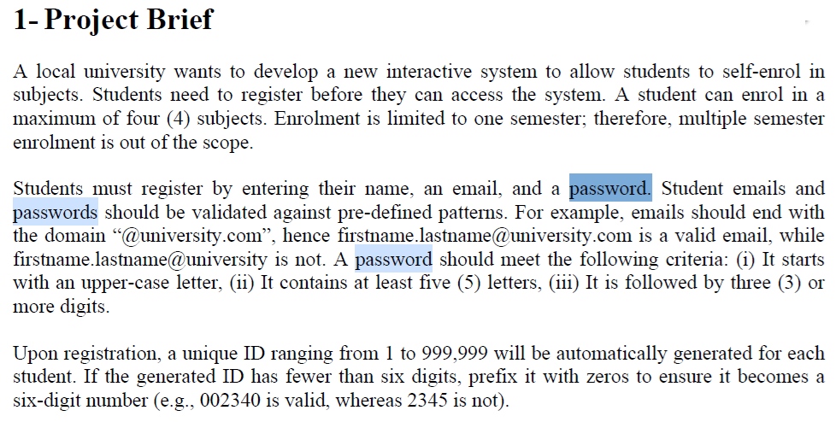
Group Assignment – Part 1: Password Rules – Clarified

Slide 43
Group Assignment – Part 1: Password Rules – Clarified
Clarification of Password Pattern
The password must start with an uppercase letter (e.g., A, B, Z).
After that, it must have at least 4 more letters (so minimum 5 letters in total including the first uppercase).

Slide 44
Finally, it must end with at least 3 digits (numbers).
✓ Example valid: Abcde123
X Invalid: abcde123 (no uppercase start), Ab12 (not enough letters), Abcdef (no digits).
So the shortest valid password looks like: Aaaaa111 → 8 characters total. Longer ones are also fine, as long as they follow the same pattern.

Slide 45
Group Assignment – Part 1: Password Rules – Clarified
What are actors?
In UML, actors are the people or external systems that interact with the application.
They are outside the system but they use it or get something from it.
In our assignment:
Student → can register, login, enrol, drop subject, view enrolments, change password.
Admin → can view students, group by grade, PASS/FAIL lists, remove students, clear data.

Slide 46
Group Assignment – Part 1: Password Rules – Clarified
So:
Actor = “who uses the system”.
Use case = “what they can do in the system.”

Slide 47
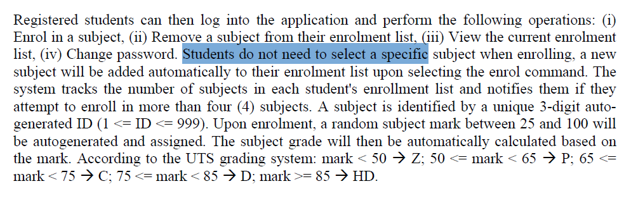
Group Assignment – Part 1: Password Rules – Clarified
2. If students register, will they manually pick a unit or automatically system will enrol them?
According to the brief:
“Students do not need to select a specific subject when enrolling, a new subject will be added automatically…”

Slide 48
Group Assignment – Part 1: Password Rules – Clarified
This means:
The system automatically generates a subject with an auto ID (3 digits).
It also gives the student a random mark (25–100) and then assigns a grade (Z, P, C, D, HD).
So students do not manually choose subjects.
They just click “enrol”, and the system adds a subject for them.

Slide 49
Group Assignment – Part 1: Password Rules – Clarified
In short,
Actors = Student + Admin.
Students don’t choose subjects manually; the system auto-enrols them when they select enrol.

Slide 50
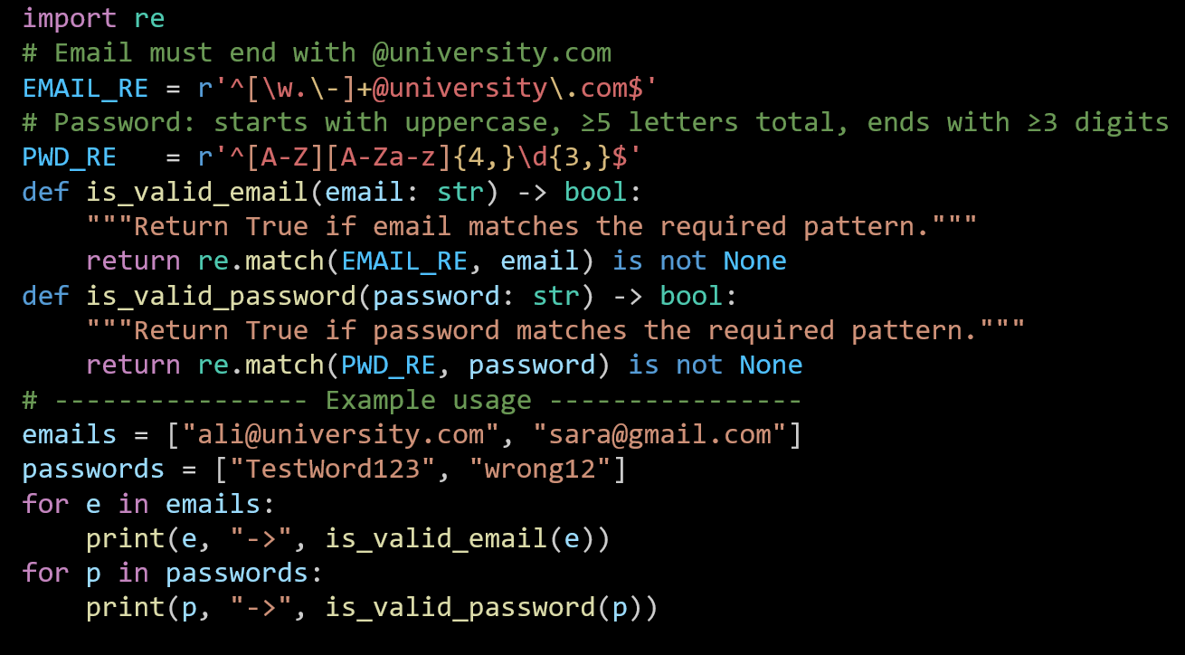
Mini Coding Nudges (Email/Password, Marks, Pass/Fail etc.)
Email & password patterns (Python):
1. import re Loads Python’s regular expression module.

Slide 51
Mini Coding Nudges (Email/Password, Marks, Pass/Fail etc.)
2. Patterns
^ start; $ end → match the whole string
[\w.\-]+ → one or more letters/digits/underscore/dot/hyphen before @
@university\.com → literal domain (the dot is escaped)
Email & password patterns (Python):

Slide 52
Mini Coding Nudges (Email/Password, Marks, Pass/Fail etc.)
Start with one uppercase [A-Z]
Then ≥4 letters [A-Za-z]{4,} → total letters ≥5
Then ≥3 digits \d{3,}
Anchored with ^ and $
Email & password patterns (Python):

Slide 53
Mini Coding Nudges (Email/Password, Marks, Pass/Fail etc.)
3. Validators
Return True/False depending on pattern match.
Email & password patterns (Python):

Slide 54
Mini Coding Nudges (Email/Password, Marks, Pass/Fail etc.)
4. Quick test Loops over sample emails/passwords and prints results.
Email & password patterns (Python):

Slide 55
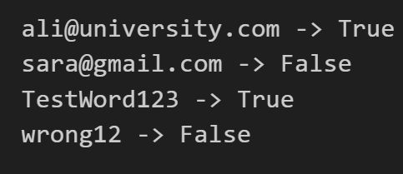
Mini Coding Nudges (Email/Password, Marks, Pass/Fail etc.)
Results:

Slide 56
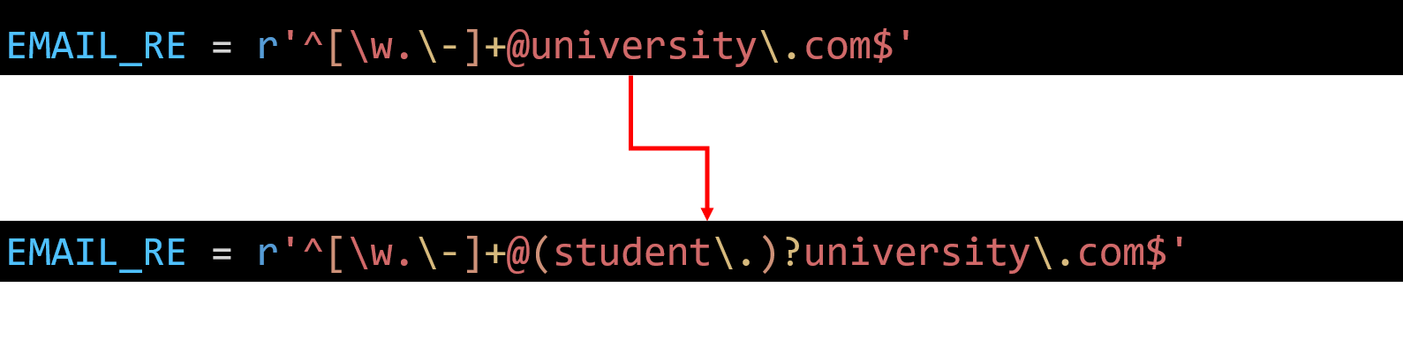
Mini Coding Nudges (Email/Password, Marks, Pass/Fail etc.)
Allow student. Subdomain too
Update the email rule so it accepts either @university.com or @student.university.com.

Slide 57
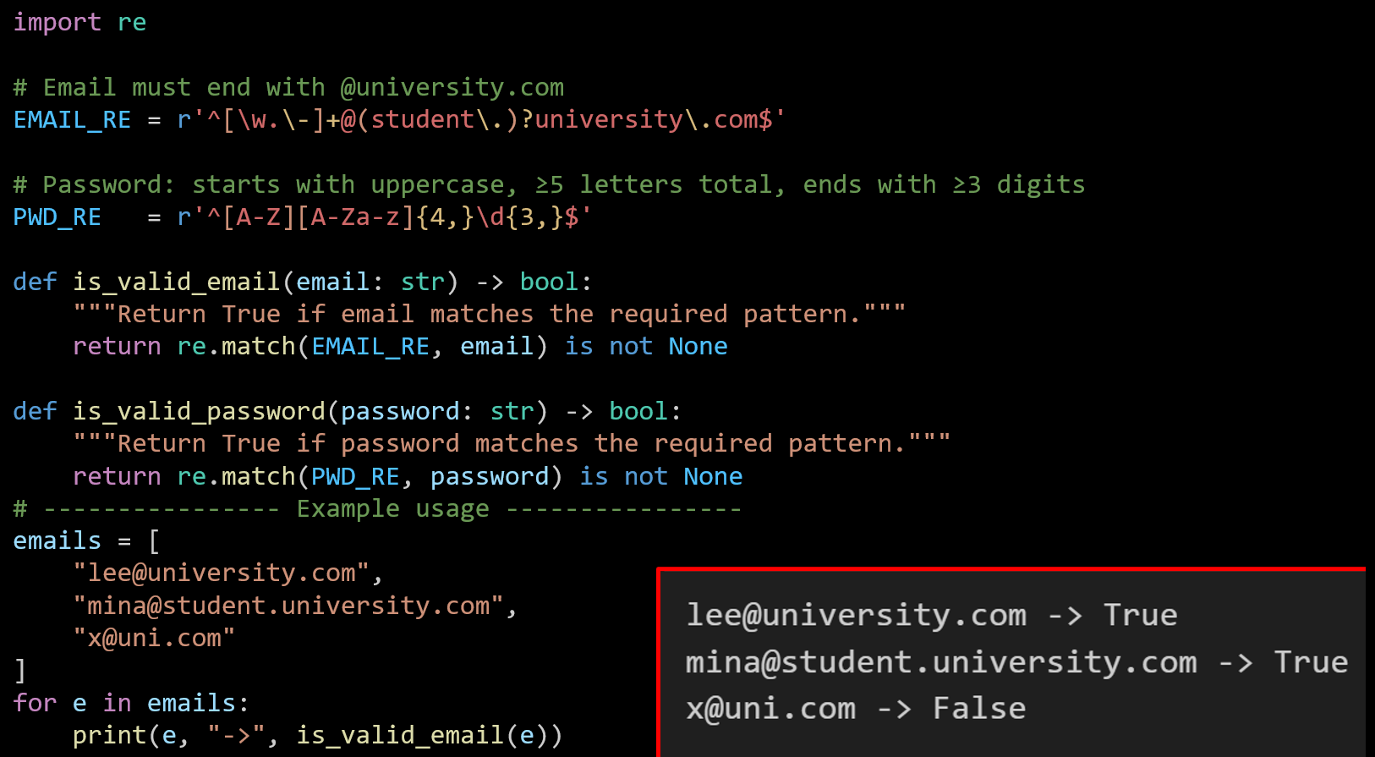

Slide 58
Allow optional - or _ before digits in password
Mini Coding Nudges (Email/Password, Marks, Pass/Fail etc.)
Change just the password regex line:
PWD_RE = r'^[A-Z][A-Za-z]{4,}\d{3,}$'
PWD_RE = r'^[A-Z][A-Za-z]{4,}[-_]?\d{3,}$'

Slide 59
Generate Random Marks and Assign Grades
Mini Coding Nudges (Email/Password, Marks, Pass/Fail etc.)
Write a function (grade(mark)) that takes a numeric mark and returns a grade (Z, P, C, D, HD) based on the mark range.
Generate a random mark between 25 and 100 using randint.
Generate a random student ID (padded with zeros to 3 digits).
Store the results in a dictionary with keys:
"id" → the random student ID
"mark" → the generated mark
"grade" → the grade returned by the function
Print the dictionary showing one student’s mark and grade.
In short, write a Python program that assigns a random mark to a student, calculates the grade, and prints the student’s ID, mark, and grade

Slide 60
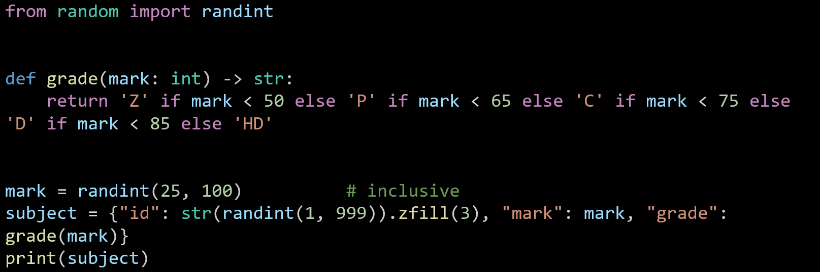
Generate Random Marks and Assign Grades
Mini Coding Nudges (Email/Password, Marks, Pass/Fail etc.)
Imports randint(a, b) to make random integers including both ends.

Slide 61
Generate Random Marks and Assign Grades
Mini Coding Nudges (Email/Password, Marks, Pass/Fail etc.)
A function that turns a numeric mark into a grade using the required bands:
<50 → Z, 50–64 → P, 65–74 → C, 75–84 → D, ≥85 → HD.

Slide 62
Generate Random Marks and Assign Grades
Mini Coding Nudges (Email/Password, Marks, Pass/Fail etc.)
Picks one random mark from 25 to 100.

Slide 63
Generate Random Marks and Assign Grades
Mini Coding Nudges (Email/Password, Marks, Pass/Fail etc.)
Creates a small record (a Python dict) for one subject:
"id" is a random number 1..999, padded to 3 digits like "007".
"mark" is the number above.
"grade" is computed by calling grade(mark).

Slide 64
Generate Random Marks and Assign Grades
Mini Coding Nudges (Email/Password, Marks, Pass/Fail etc.)
Prints something like: {'id': '087', 'mark': 78, 'grade': 'D'}.

Slide 65
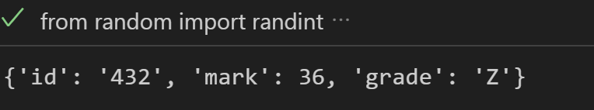
Generate Random Marks and Assign Grades
Mini Coding Nudges (Email/Password, Marks, Pass/Fail etc.)

Slide 66
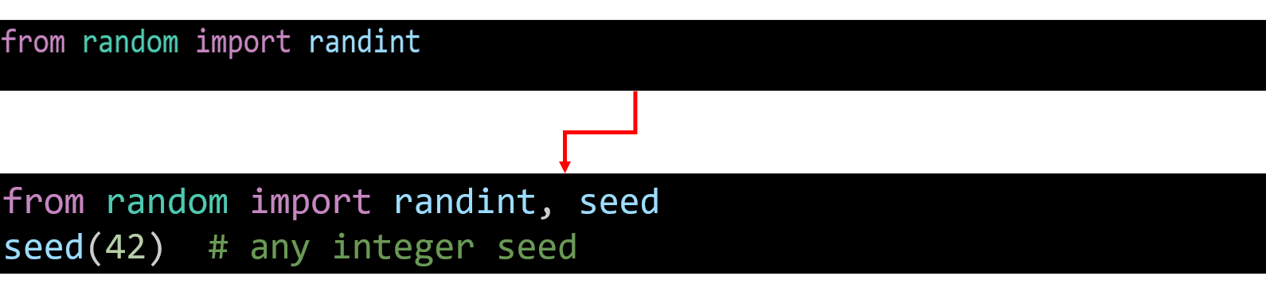
Make randomness reproducible
Mini Coding Nudges (Email/Password, Marks, Pass/Fail etc.)
Task: Add a seed so repeated runs give the same result (useful for testing).

Slide 67
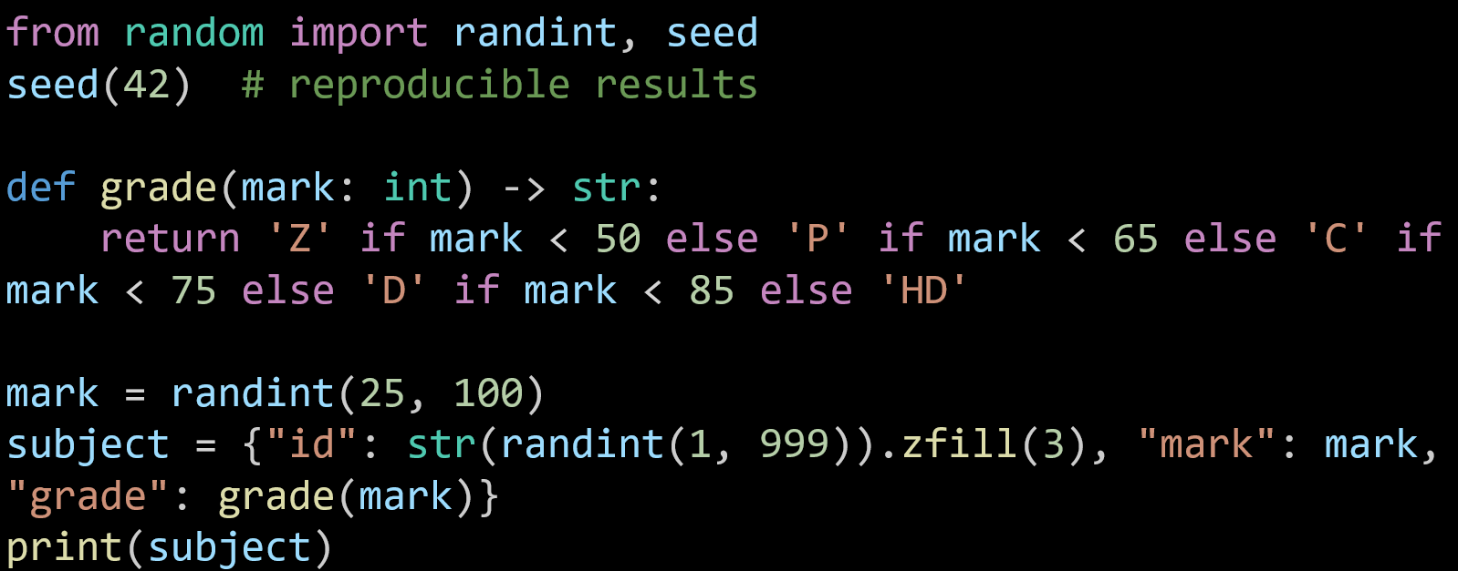
Brings in two functions from Python’s random library:
randint(a, b): makes a random whole number between a and b (both included).
seed(x): fixes the random numbers so you get the same result each time (useful for testing).

Slide 68
Sets the “starting point” for the random generator.
Without this, each run gives different results.
With it, the numbers repeat every time, which makes testing easier.

Slide 69
Defines a function called grade:
Input: a number (mark) between 25–100.
Output: a single letter grade, based on rules:
<50 → 'Z'
50–64 → 'P'
65–74 → 'C'
75–84 → 'D'
≥85 → 'HD'

Slide 70
Generates one random exam mark between 25 and 100 and stores it in the variable mark.

Slide 71
Creates a dictionary (like a mini record) for one subject:
"id" → random number 1–999, but .zfill(3) pads it with zeros so it always looks like 001, 045, 234.
"mark" → the random mark generated above.
"grade" → the letter grade, calculated by calling grade(mark).

Slide 72
Shows the whole dictionary on screen.

Slide 73
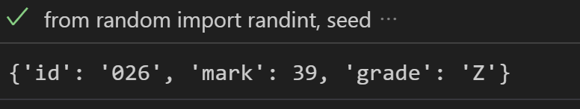
Make randomness reproducible
Mini Coding Nudges (Email/Password, Marks, Pass/Fail etc.)
In short:
Fix the random seed,
Generate a random mark + subject ID,
Work out the grade,
Print the record.
from random import randint, seed
seed(42) # reproducible results
def grade(mark: int) -> str:
return 'Z' if mark < 50 else 'P' if mark < 65 else 'C' if mark < 75 else 'D' if mark < 85 else 'HD'
mark = randint(25, 100)
subject = {"id": str(randint(1, 999)).zfill(3), "mark": mark, "grade": grade(mark)}
print(subject)

Slide 74
Add student ID and PASS/FAIL
Mini Coding Nudges (Email/Password, Marks, Pass/Fail etc.)
Task: Add a 6-digit student ID and a pass/fail flag (pass if mark ≥ 50). Hint: Use zfill(6) for the student ID.

Slide 75
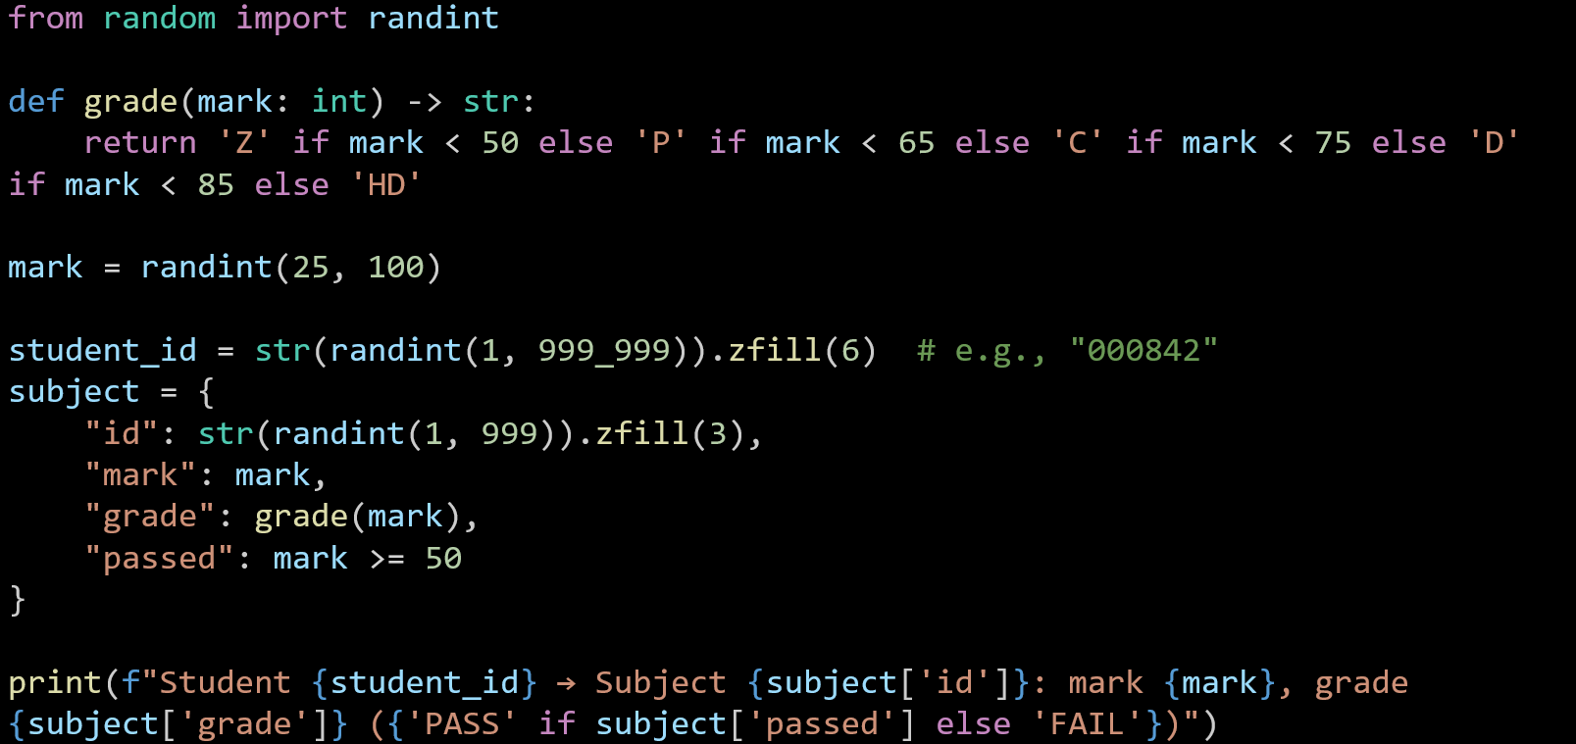
Mini Coding Nudges (Email/Password, Marks, Pass/Fail etc.)

Slide 76
Mini Coding Nudges (Email/Password, Marks, Pass/Fail etc.)
Student 256788 → Subject 229: mark 60, grade P (PASS)

Slide 77
Grade Classification Based on University Rules
Mini Coding Nudges (Email/Password, Marks, Pass/Fail etc.)
Write a function grade(mark: int) -> str that returns the grade according to UTS rules.
Use if–else conditions (or chained expressions).
Test your function with example marks [42, 58, 70, 82, 95].
Print each mark alongside its grade.
You’ve basically turned the earlier randomised activity into a deterministic grading demo — perfect for classroom explanation before students move to random generation.

Slide 78
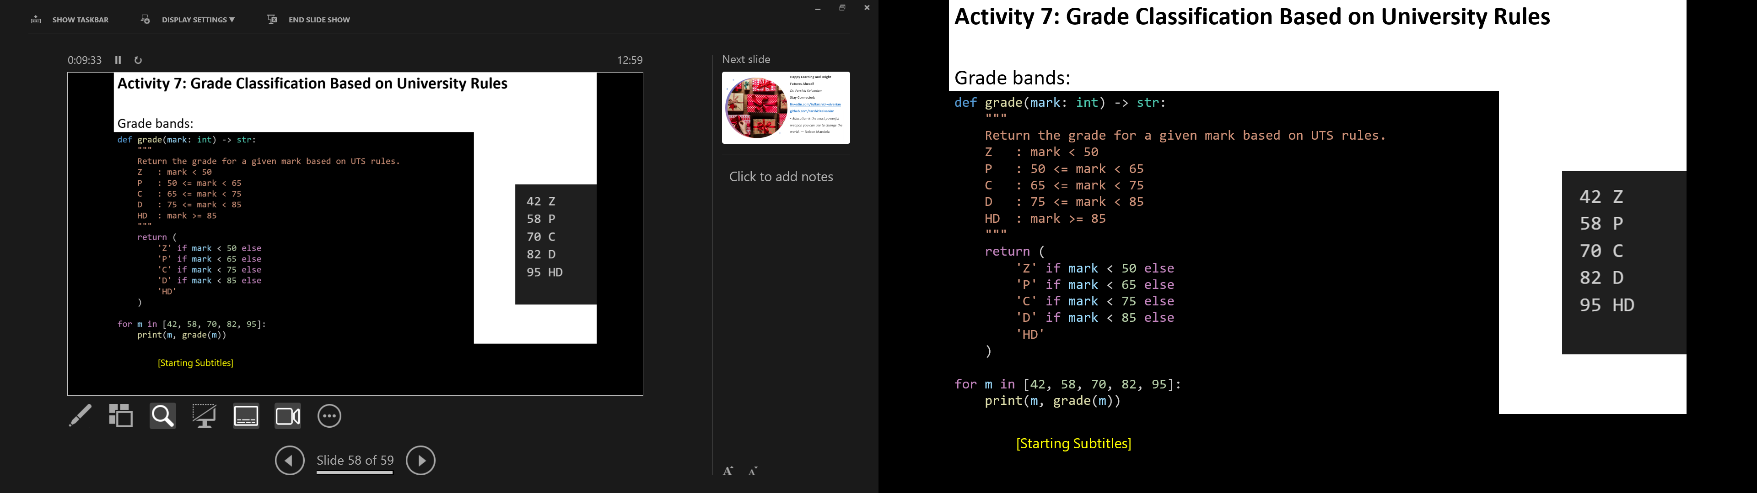
Mini Coding Nudges (Email/Password, Marks, Pass/Fail etc.)
mark: int -> str are type hints: input is an integer, output is a string.
The big return uses a chain of checks from lowest to highest.

Slide 79
Mini Coding Nudges (Email/Password, Marks, Pass/Fail etc.)
Python evaluates them in order:
If mark < 50, stop and return 'Z'.
Otherwise, if mark < 65, return 'P'.
Otherwise, if mark < 75, return 'C'.
Otherwise, if mark < 85, return 'D'.
Otherwise (so mark ≥ 85), return 'HD'.

Slide 80
Mini Coding Nudges (Email/Password, Marks, Pass/Fail etc.)
Boundaries (exact edges)
50 → P (not Z)
65 → C
75 → D
85 → HD

Slide 81
Mini Coding Nudges (Email/Password, Marks, Pass/Fail etc.)
That’s all—it’s just a top-to-bottom check that stops at the first band that fits.

Slide 82
Group Assignment – Part 2: Build hints (Python-first, JavaFX minority)
Python CLI structure (suggestion):
models/Student.py, Subject.py
services/auth.py, id_gen.py, grade.py, store.py
cli/university_menu.py, student_menu.py, admin_menu.py
Data file: students.data (JSONL).
Keep regex as constants; wrap file I/O with try/except; always re-write the file after CRUD.

Slide 83
Group Assignment – Part 2: Build hints (Python-first, JavaFX minority)
JavaFX (optional challenge later):
MVC folders: model/, controller/, view/ (FXML).
Start with login window → enrolment window.
Read registered students from students.data.

Slide 84
Group Assignment – Part 2: Build hints (Python-first, JavaFX minority)
Coding do/avoid:
Do unit-size functions (e.g., assign_mark_and_grade()), no giant methods.
Do input validation; mirror sample I/O wording.
Avoid plaintext passwords in examples (hash in design; for Part 2, at minimum note hashing TODO).
Avoid mixing model and menu logic; keep menus thin.

Slide 85
Group Assignment – Part 3: Showcase tips
Plan a 5–7 min script:
Open app → show University → Student/Admin navigation.
Student flow: register/login → enrol (cap at 4) → show → remove → change password.
Admin flow: list → group by grade → PASS/FAIL → remove → clear.
Code walkthrough: each member shows their class/function for ~45–60s (what it does, where it’s called). Avoid: live debugging on stage; changing scope; reading long code blocks.

Slide 86
Example & Activity — Event Ticketing Lite
Mini case
Users create Events (title, date). Users can book Tickets. One user can book many tickets; an event has many tickets → many-to-many via Booking association class (bookingId, qty, timestamp). An event may have a parent event (series) → reflexive association. Tickets can be PENDING/CONFIRMED/CANCELLED (simple state).
Think of Candidate Classes, Key Relationships, Sample Backlogs IDs,

Slide 87
Example & Activity — Event Ticketing Lite
Candidate classes
User (id, name, email)
Event (id, title, date, parentEvent?) (reflexive)
Ticket (id, price, state)
Booking (association class between User and Event): qty, timestamp
Store for file I/O

Slide 88
Example & Activity — Event Ticketing Lite
Key relationships
User M ── M Event through Booking (association class)
Event 0, 1 ── 0, M Event (reflexive “is part of series”)
Booking 1 ── M Ticket (composition: tickets belong to that booking)

Slide 89
Example & Activity — Event Ticketing Lite
Sample backlog IDs
100 Register/login user
200 Create event
300 Book tickets / include check availability / include save
310 Cancel booking / extend show refund notice
400 List events and my bookings

Slide 90
Example & Activity — Event Ticketing Lite
Activity:
Association class practice: Draw Booking between User and Event with attributes; add multiplicities on both sides.
Reflexive association: Add Event → Event “parentOf”; mark multiplicity 0..1 to 0..M.
State note: Add a note listing Ticket.state ∈ {PENDING, CONFIRMED, CANCELLED} and link it to cancellation use case as an extend.

Slide 91
Reference Note for Students
The main reference for this assignment is the official instructions provided on Canvas: Assignments – Part 1: Analysis and Design
This PowerPoint is designed to guide you and clarify the task where things might feel confusing. If you are ever unsure, please always go back to the official Canvas instructions as the source of truth.

Slide 92

Happy Learning and Bright Futures Ahead! Dr. Farshid Keivanian Stay Connected: linkedin.com/in/farshid-keivanian github.com/FarshidKeivanian
Education is the most powerful weapon you can use to change the world. — Nelson Mandela

